Slide 1
Image analysis
Point Processing
Image Enhancement in the Spatial Domain
Image processing

Slide 2
Image Analysis
אלגברה התמונה
Addition – חיבור Substractionחיסור –
Multiplication – כפל Division - חילוק
גיאומטריית התמונה
Zoom - זום Translateהזזה - Crop -קרופ
Shrink - כיווץ Rotate - סיבוב Enlarge – הגדלה
פעולות לוגיות (בוליאניות)
AND, OR, NOT – או, לא וגם
Image processing

Slide 3
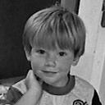
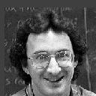

Image Addition
First original image
Second original image
Addition of first and second Images
Image processing

Slide 4
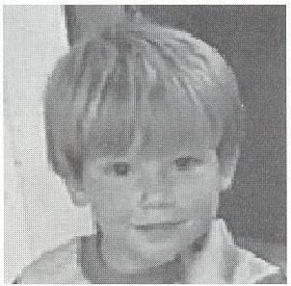
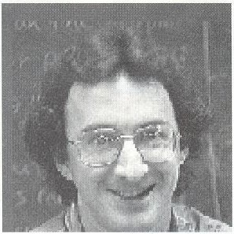
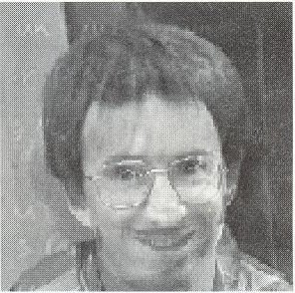
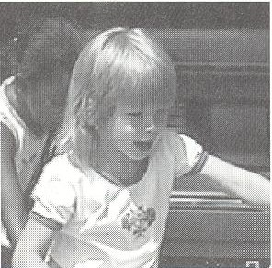
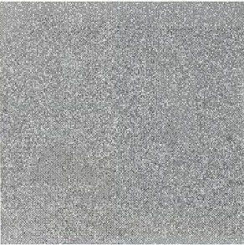
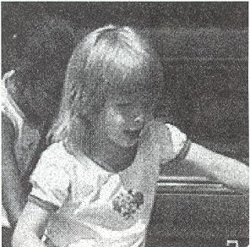
Image addition
Image Morphing Example
+
=
Additive Noise example
+
=
Image processing

Slide 5
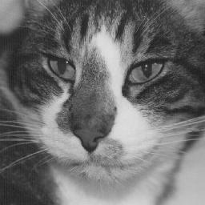
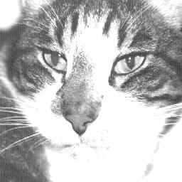
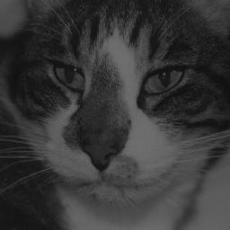
Image Multiplication and Division
Original Image
Image Multiplied by 2
Image Divided by 2
Image processing

Slide 6
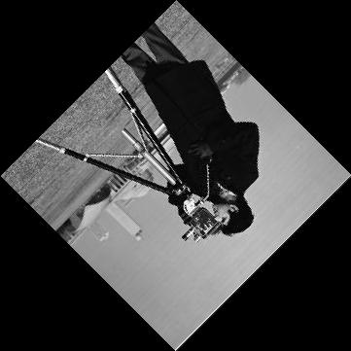
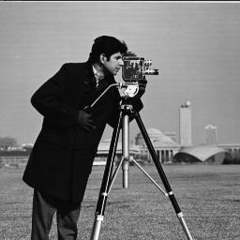
Image Rotation
Original image
Original image rotated clockwise by 135 degrees
Image processing

Slide 7
Rotation and Translation
θ
x
x
x’
b. Fix by translating toward corner
a. Image is rotated off the screen
Image processing
c. Translation complete
d. Crop and enlarge if desired

Slide 8
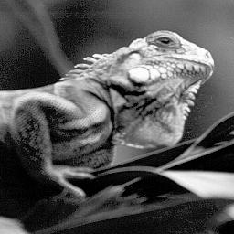

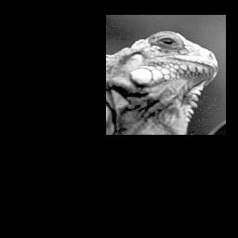

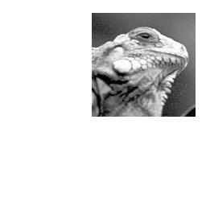
The logic operations AND and OR
a.
b.
c.
a. Original image
b. Square for AND mask
c. Resulting image
d. Square for OR mask
e. Resulting image
Image processing
e.
d.

Slide 9
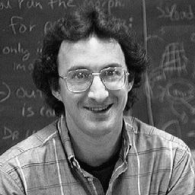
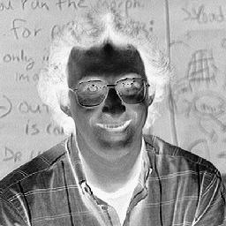
The NOT operation
Original image
NOT operator applied to image
Image processing

Slide 10
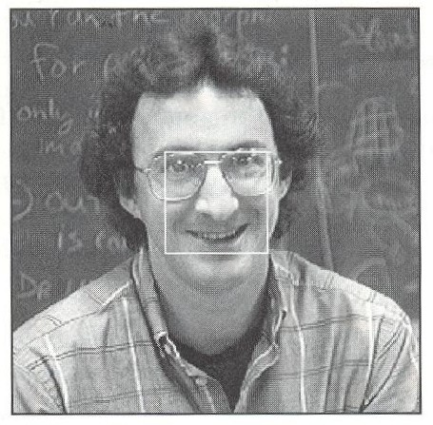
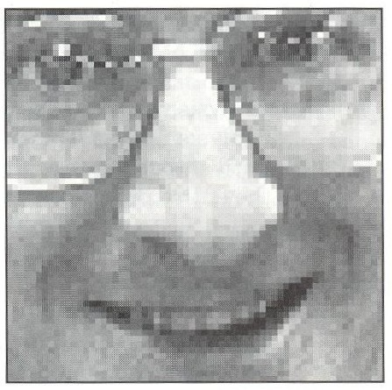
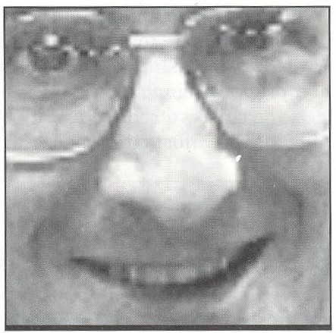
Zooming Methods
b.
a.
a. Original image. Area to be zoomed is outlined in center.
b. Image enlarged by zero-order hold. Note the blocky effect
c. Image enlarged by first order hold. Note the smoother effect
c.
Image processing

Slide 11
Image Quantization
תהליך צמצום נתוני התמונה באמצעות ביטול חלק מהמידע שבתמונה ע"י מיפוי קבוצת נקודות לנקודה אחת.
I(r,c) – צמצום רמות אפור
(r, c – קואורדינטות מרחביות)
Image processing

Slide 12
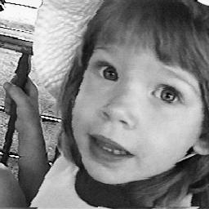
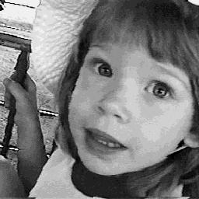
Gray-Level Quantization
קווינטוט רמות אפור הוא מיפוי של קבוצות ערכי רמות אפור לרמה אחת.
Original Image
Image after gray-level operation
Image processing
Notes:
The process of reducing the image data by removing some information by mapping groups of data points to a single point done to the pixel values is called gray-level quantization.

Slide 13
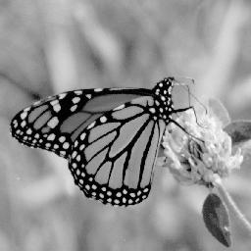

Improved Gray Scale (IGS) Quantization
קווינטוט רמות אפור משופר נועד להקטין את אפקט הקצוות הלא-נכונים. שיטת קרא"מ משתמשת ברגישות מערכת הראיה של האדם לקצוות ע"י הוספת מספר אקראי קטן לכל פיקסל לפני הקווינטוט, והתוצאה היא תמונה יותר יפה.
Original image
IGS Quantization, eight levels
Image processing
Notes:
Improved Gray Scale Quantization is used to reduce the false contouring effect. The IGS method takes advantage of the human visual system's sensitivity to edges by adding a small random number to each pixel before quantization, which results in a more visually pleasing appearance.

Slide 14
Principle Objective of Enhancement
Process an image so that the result will be more suitable than the original image for a specific application.
The suitableness is up to each application.
A method which is quite useful for enhancing an image may not necessarily be the best approach for enhancing another images
Image processing

Slide 15
Good images
For human visual
  The visual evaluation of image quality is a highly subjective process.
  It is hard to standardize the definition of a good image.
For machine perception
  The evaluation task is easier.
  A good image is one which gives the best machine recognition results.
A certain amount of trial and error usually is required before a particular image enhancement approach is selected.
Image processing

Slide 16
Point Processing
Neighborhood = 1x1 pixel
T-- gray level (or intensity or mapping) transformation function
s = T(r)
where
r-- gray level of an image I=f(x,y)
s-- gray level of an image J=g(x,y)
Image processing

Slide 17
Histogram Processing
Histogram of a digital image with gray levels in the range [0,L-1] is a discrete function
h(r_{k}) = n_{k}
where
  r_{k} : the k^{th} gray level
  n_{k} : the number of pixels in the image having gray level r_{k}
  h(r_{k}) : histogram of a digital image with gray levels r_{k}
  Figure 2. shows a sample histogram for a simple image.
Image processing

Slide 18
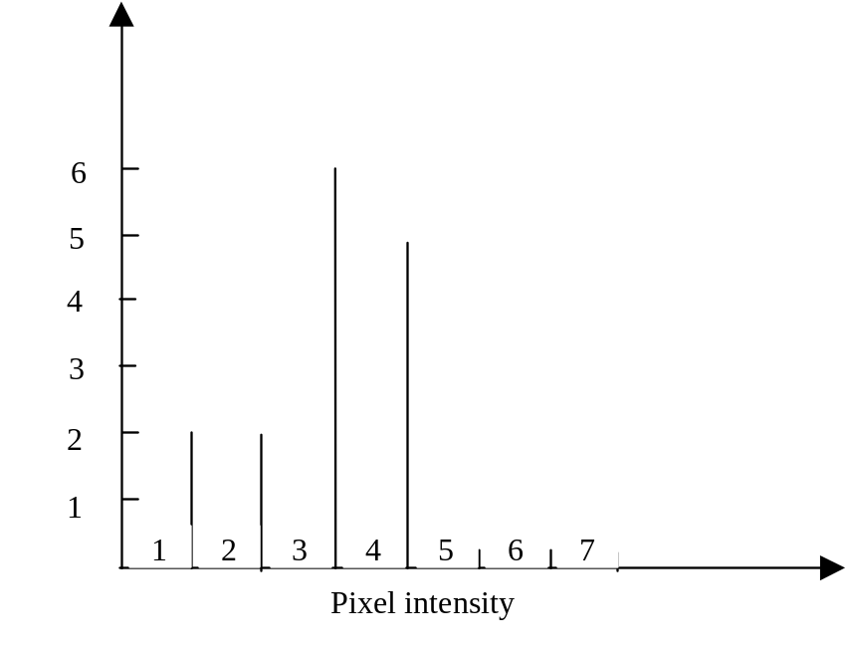
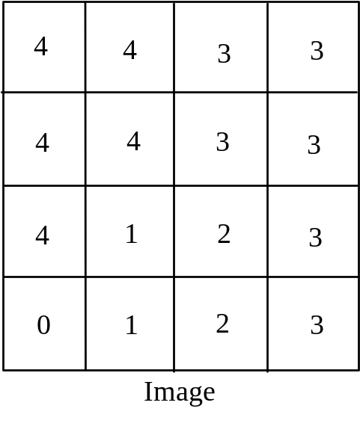
Sample image with histogram
Image processing

Slide 19
Example of one-point processing
The image histogram processing used to view the intensity profile of an image. The histogram provides information about the contrast and overall intensity distribution of an image. The image histogram is simply a bar graph of the pixel intensities. The pixel intensities are plotted along the x-axis and the number of occurrences for each intensity represents the y-axis.
Image processing

Slide 20
Images with good contrast exhibit a wide range of pixel values.
In the follow figure the histogram displays a relatively uniform distribution of pixel values. There are no major peaks or valleys in the histogram.
Image processing

Slide 21

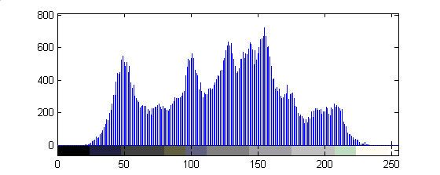
Uniform histogram
Image processing

Slide 22
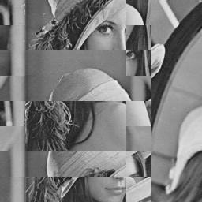
Histograms (cont.)
These images have exactly the same histograms!
Image processing

Slide 23
Images with high contrast have regions of both dark and light. High contrast images utilize the full range available.
The problem with high contrast images is that they have large regions of dark and large regions of white. One peak is centered in the lower region and the other in the high region.
Image processing

Slide 24
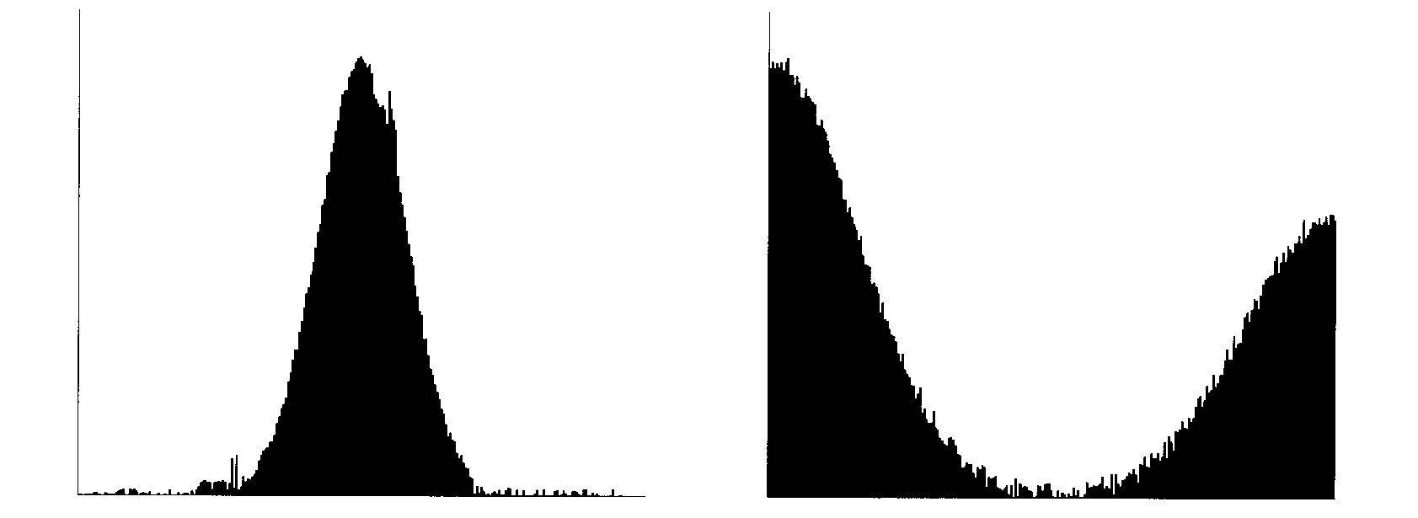
Low and high contrast histograms
The histograms of high contrast images have two big peaks.
Image processing

Slide 25
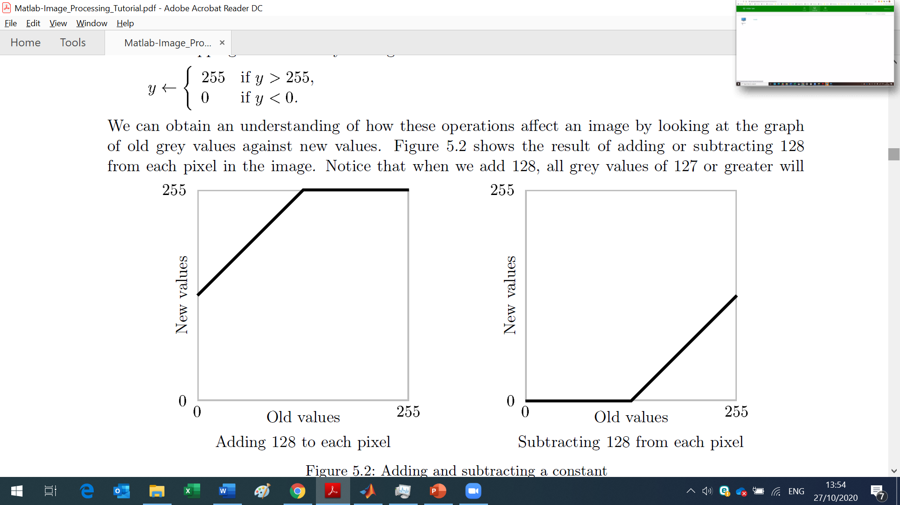
Arithmetic operations on an image: adding and subtracting a constant
Image processing

Slide 26
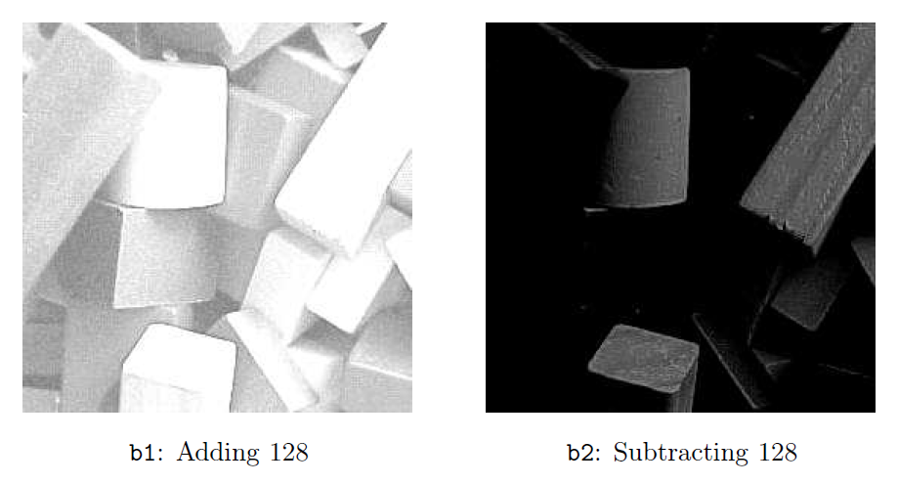
Arithmetic operations on an image: adding and subtracting a constant
b1=uint8(double(b)+128);
b2=uint8(double(b)-128);
Image processing

Slide 27
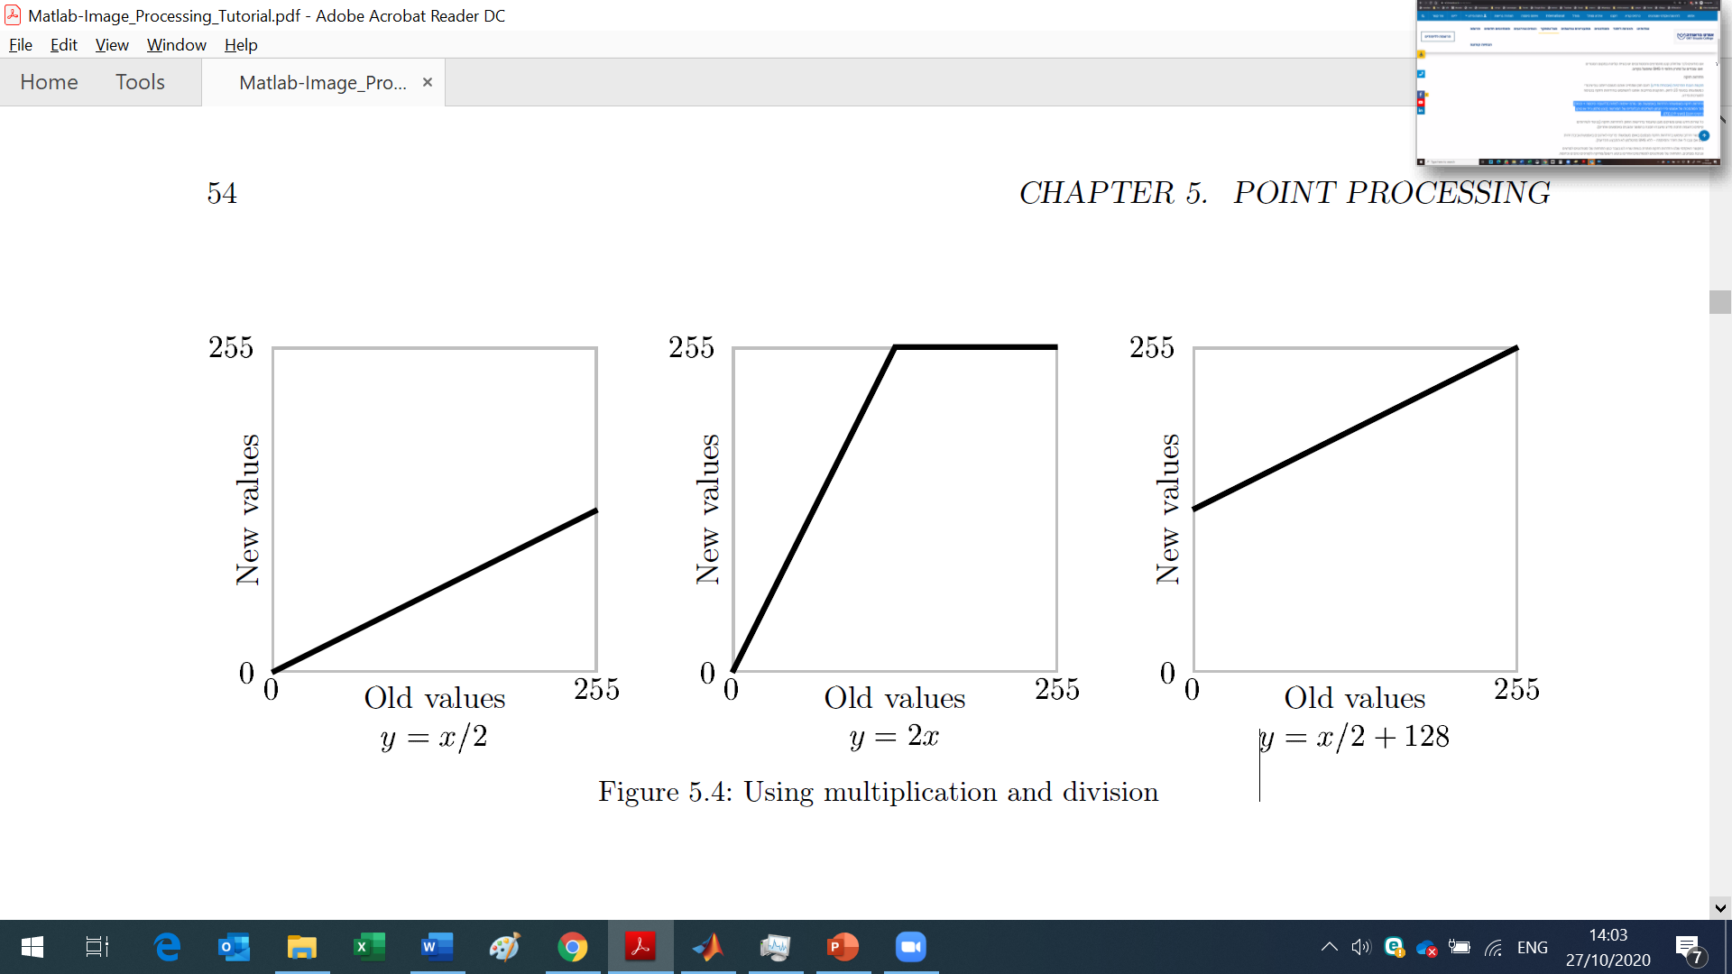
Arithmetic operations on an image:
adding and subtracting
Image processing

Slide 28
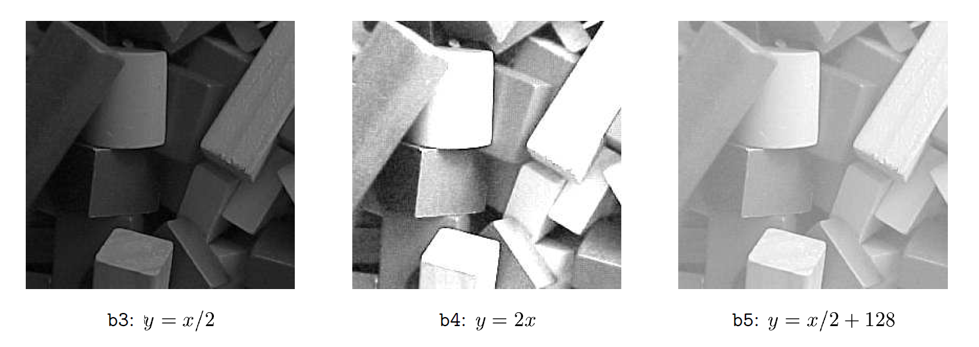
Arithmetic operations on an image:
adding and subtracting
Image processing

Slide 29
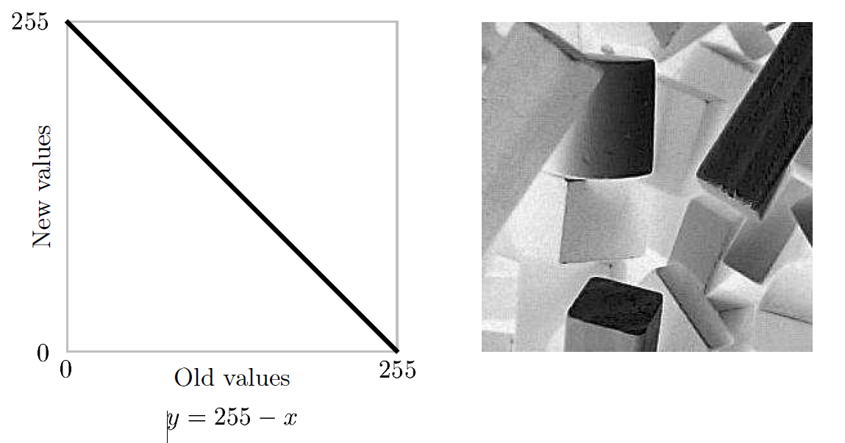
Arithmetic operations on an image:
Image complementation
Image processing

Slide 30
Arithmetic operations on an image:
Image complementation
Image processing

Slide 31
Image Enhancement
Histogram Modification
a. Histogram stretch
b. Histogram shrink
c. Histogram slide
Image processing

Slide 32
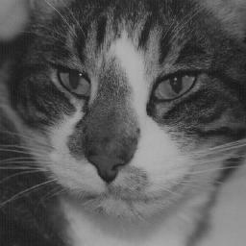
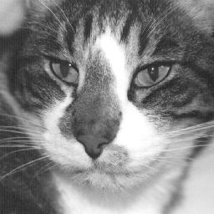
Gray-Scale Modification
שיטות שינוי רמות אפור שייכות לקבוצת פעולות נקודה. פונקציה זו משנה את ערכו של הפיכסל במשוואת המיפוי. משוואת מיפוי זו ממפה את רמות האפור המקוריות לערכים אחרים. שימושיה כוללים הגברת ניגודיות והגברת תכונה.
Original Image
Image after Gray-Scale Modification
Image processing
Notes:
Gray-Scale Modification ( also called gray-level scaling ) methods belongs in the category of point operations. This function changes the pixel's value by a mapping equation. This mapping equation maps the original gray-level values to other, specified values. Its applications include contrast enhancement and feature enhancement.

Slide 33
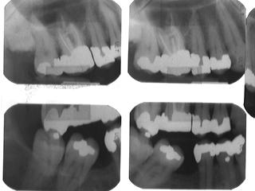
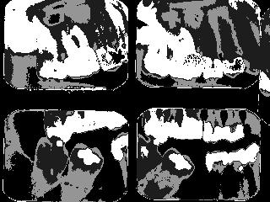
Intensity-Level Slicing
משוואת מיפוי הקיימת לחילוץ תכונה נקראת חיתוך לפי בהירות. בשיטה זו אנו בוחרים ערכי רמות אפור מסויימים לעניין וממפים אותם לערכים מיוחדים (בד"כ גבוהים/בהירים).
Original Image
Image sliced to emphasize gray values
Image processing
Notes:
Mapping equation used for feature extraction, is called intensity-level slicing. In this method we select a specific gray-level values of interest and map them to a specified ( typically high/bright ) values.

Slide 34
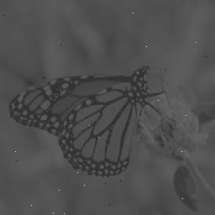
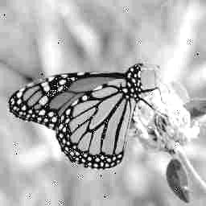
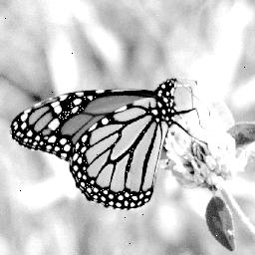
Histogram Stretching with Clipping
A pure histogram stretching will not improve the image if few pixel values don't fall within a small range but span the entire range. In this case a small percentage of pixel values are clipped at the high end and low end of the range ( for an 8-bit image truncating at 0 and 255 ) , this method of improving the contrast of the image is called histogram stretching with clipping
Original Image
Image after histogram stretching with clipping
Image after histogram stretching without clipping
Image processing
Notes:
A pure histogram stretching will not improve the image if few pixel values don't fall within a small range but span the entire range. In this case a small percentage of pixel values are clipped at the high end and low end of the range ( for an 8-bit image truncating at 0 and 255 ) , this method of improving the contrast of the image is called histogram stretching with clipping

Slide 35
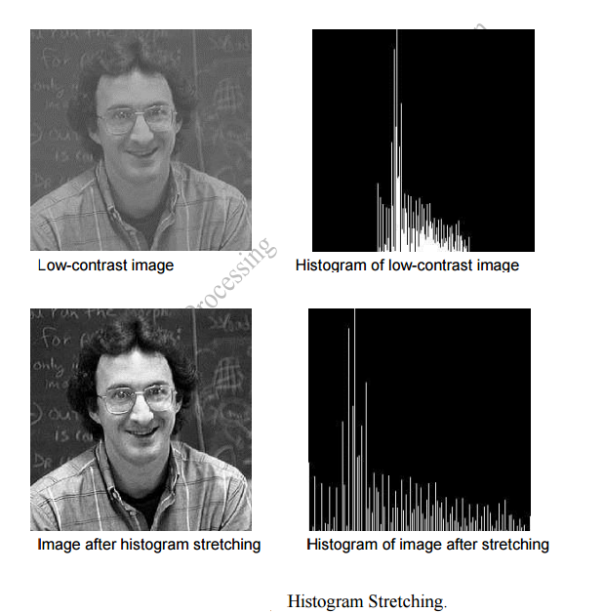
Histogram Stretching
Image processing
Notes:
A pure histogram stretching will not improve the image if few pixel values don't fall within a small range but span the entire range. In this case a small percentage of pixel values are clipped at the high end and low end of the range ( for an 8-bit image truncating at 0 and 255 ) , this method of improving the contrast of the image is called histogram stretching with clipping

Slide 36
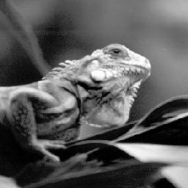
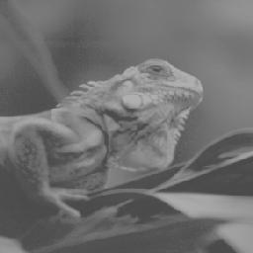
Histogram Shrinking
Histogram Shrinking produces an image of reduced contrast.
Original Image
Image after histogram shrinking
Image processing

Slide 37
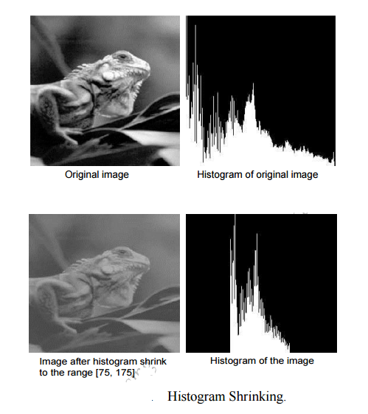
Histogram Shrinking
Image processing
Notes:
A pure histogram stretching will not improve the image if few pixel values don't fall within a small range but span the entire range. In this case a small percentage of pixel values are clipped at the high end and low end of the range ( for an 8-bit image truncating at 0 and 255 ) , this method of improving the contrast of the image is called histogram stretching with clipping

Slide 38

Histogram Shrinking
The opposite of a histogram stretch is a histogram shrink, which will decrease image contrast by compressing the gray levels. The mapping function for a histogram shrinking can be found by the following equation:
Shrink max and shrink min correspond to the maximum and minimum desired in the compressed histogram. In general, this process produces an image of reduced contrast and may not seem to be useful an image enhancement.
Image processing
Notes:
A pure histogram stretching will not improve the image if few pixel values don't fall within a small range but span the entire range. In this case a small percentage of pixel values are clipped at the high end and low end of the range ( for an 8-bit image truncating at 0 and 255 ) , this method of improving the contrast of the image is called histogram stretching with clipping

Slide 39
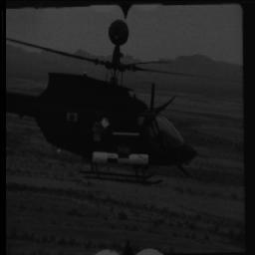
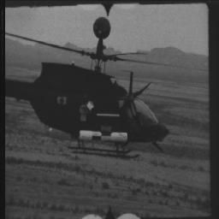
Histogram Sliding
שיטת גלישת ההיסטוגרמה קיימת להפיכת תמונה לבהירה יותר או לכהה יותר אבל תוך שמירה על היחס בין ערכי רמות אפור. תוצאה זו משיגים ע"י הוספה או חיסור של מספר קבוע מכל רמות האפור.
Original Image
Image after positive-value histogram sliding
Image processing
Notes:
Histogram slide technique is used to make an image either darker or lighter but retains the relationship between gray-level values. This is achieved by simply adding or subtracting a fixed number from all the gray-level values.

Slide 40
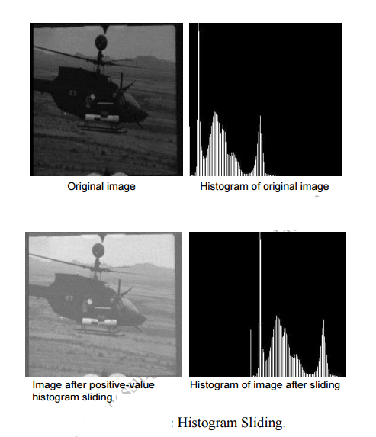
Histogram Sliding
Image processing
Notes:
A pure histogram stretching will not improve the image if few pixel values don't fall within a small range but span the entire range. In this case a small percentage of pixel values are clipped at the high end and low end of the range ( for an 8-bit image truncating at 0 and 255 ) , this method of improving the contrast of the image is called histogram stretching with clipping

Slide 41
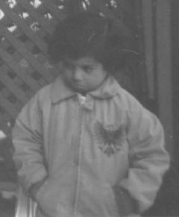
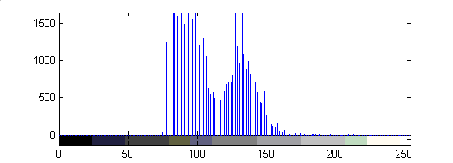

Histogram stretching
a = 74
b = 224
Stretching if (B-A)/(b-a) > 1
Image processing

Slide 42


Histogram stretching (cont.)
a = 74
b = 224
Image processing

Slide 43


Histogram stretching (adjustment)
Image processing
a = 74
b = 160

Slide 44




Histogram stretching Example
a. Original dark image
b. Histogram of image (a)
Image processing
c. Dark image after histogram stretching
d. Histogram of image (c)

Slide 45




Histogram stretching Example (cont.)
a. Original light image
b. Histogram of image (a)
c. Light image after histogram stretching
d. Histogram of image (c)
Image processing

Slide 46




Histogram Equalization
היא לעיתים קרובות נותנת תוצאה יותר יפה בתחום רחב יותר של התמונות.
Original dark image before and after histogram equalization
Original light image before and after histogram equalization
Image processing

Slide 47




Histogram equalization
Image processing

